Slide 1
MATH AND DATE METHODS IN JAVASCRIPT
Hrishikesh Pendurkar

Slide 2
INTRODUCTION TO JAVASCRIPT MATH
In this guide, we will explore JavaScript’s Math and Date methods. Understanding these methods is crucial for performing calculations and managing time effectively in your applications. Let’s dive into the essentials of these powerful tools and how they can enhance your coding experience.

Slide 3
UNDERSTANDING MATH METHODS
Math methods in JavaScript provide a range of functions to perform mathematical operations. From basic arithmetic to complex calculations, these methods allow developers to manipulate numbers efficiently. Mastering these functions is essential for JavaScript programmer.

Slide 4
KEY MATH FUNCTIONS
Some of the most important Math functions include Math.max(), Math.min(), and Math.random(). These functions help you find the maximum or minimum values in a dataset and generate random numbers, respectively. Understanding these can significantly improve your coding skills.

Slide 5
ROUNDING NUMBERS
JavaScript offers several methods for rounding numbers Math.round(), Math.ceil() and Math.floor(). Each method serves a specific purpose, whether you need to round to nearest interger, round up, or round down. Knowing when to use each method is vital.

Slide 6
WORKING WITH TRIGONOMETRY
Trigonometric functions like Math.sin(), Math.cos(), and Math.tan() are essential for calculations involving angles and triangles. These functions are crucial for applications in graphics, physics simulations and more. Mastering these will expand your programming capabilities.

Slide 7
DATE OBJECT OVERVIEW
The Date object in JavaScript allows you to work dates and times. It provides methods to get and set date values, compare dates, and perform date arithmetic. Understanding how to utilize the Date object is key for any time-sensitive applications.

Slide 8
CREATING DATE INSTANCES
You can create new Date instance using the Date() constructor. This allows you to represent specific points in time. Familiarity with the various formats for creating dates is crucial for effective date manipulation in your applications.

Slide 9
FORMATTING DATES
JavaScript provides methods like toLocateDateString() and toISOString() for formatting dates. Proper formatting is essential for displaying dates in user-friendly ways. Understanding these methods will enhance the usability of your applications.

Slide 10
DATE ARITHMETIC
Performing date arithmetic is possible by manipulating the timestamp values of Date objects. You can add or subtract dates, months, or years to calculate future or past dates. This is particularly useful for scheduling applications.

Slide 11
TIME ZONES AND UTC
Understanding time zones and UTC is crucial when working with dates. JavaScript provides methods to convert between local time and UTC, ensuring your applications handle time correctly across different regions.

Slide 12
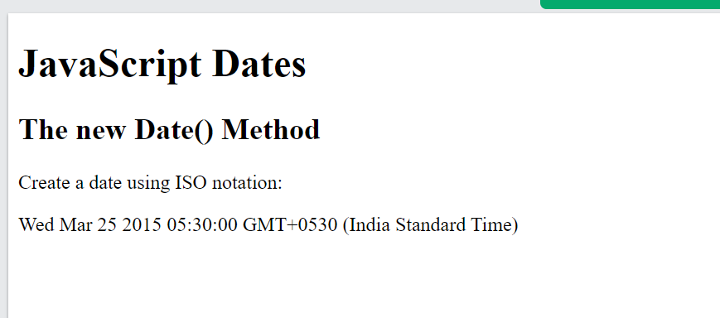
<script>
const time = new Date("2015-03-25");
document.getElementById("demo").innerHTML = time;
</script>

Slide 13
COMMON PITFALLS
Be aware of common pitfalls when using Math and Date methods, such as floating-point precision issues and date parsing inconsistencies. Understanding these challenges will help you write more robust and error-free code.

Slide 14
CONCLUSION AND BEST PRACTICES
In conclusion, mastering Math and Date methods in JavaScript is essential for any developer. By applying best practices and understanding their functionalities, you can enhance your coding efficiency and build more reliable applications. Keep Practicing and exploring.

Slide 15

THANKS

